Slide 1
Apache Pig

Slide 2
Apache pig
Apache pig is a scripting platform for big data processing that is developer friendly, is easy to learn, and can process all types of data.
The language used for pig is ‘pig latin’.

Slide 3
Evolution of MapReduce
Traditional RDBMSs and data warehouse systems cannot scale to the growing size and needs of data management, So google introduced two parallel computing technologies, GFS and MapReduce, to address big data problems related to storage and data processing.
Doug Cutting, inspired by the google technologies, created a technology called Hadoop with two modules: HDFS and MapReduce.
HDFS and MapReduce are the same as Google GFS and MapReduce with respect to functionality.

Slide 4
Evolution of MapReduce
MapReduce has proven itself in big data processing and has become the base platform for current and future big data technologies.

Slide 5
Problems of MapReduce
MapReduce is a low-level API.
You need to think in terms of the key and value every time you use it.
In addition, MapReduce has a lengthy development time.
It cannot be used for ad hoc purposes.

Slide 6
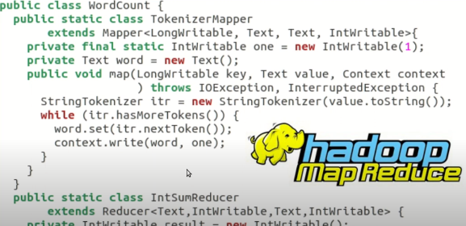

Slide 7
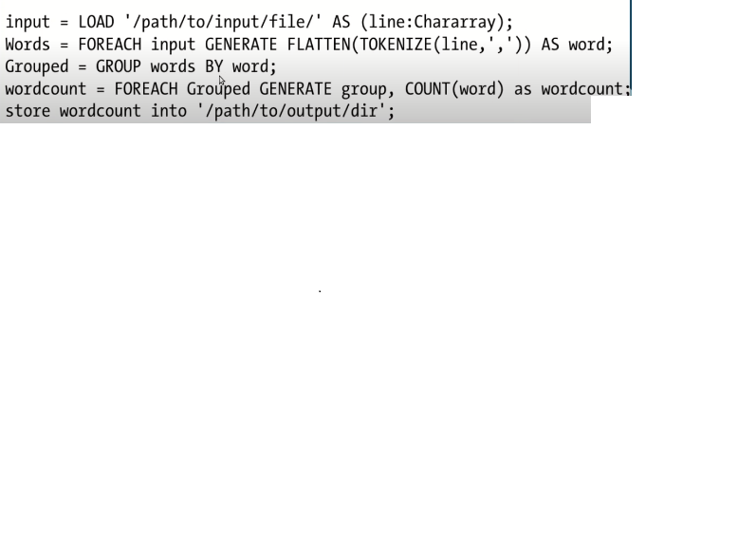

Slide 8
PIG Philosophy
Pig eat everything
Pigs live anywhere
Pigs are domestic animals.

Slide 9
Pig Latin
Apache Pig is a high-level data flow platform for executing MapReduce programs of Hadoop. The language used for Pig is Pig Latin.

Slide 10
Data Model of Pig
A Relation is the outermost structure of the Pig Latin data model. And it is a bag where −
A bag is a collection of tuples.
A tuple is an ordered set of fields.
A field is a piece of data.

Slide 11
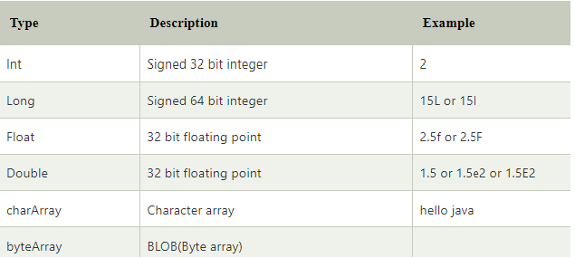
Pig Data Types

Slide 12
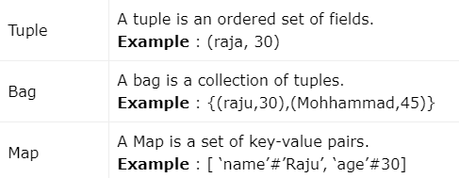
Complex Data Types

Slide 13
Pig Operators
Arithmetic Operators
Comparison Operators
Type Constructor Operators
Relational Operators

Slide 14
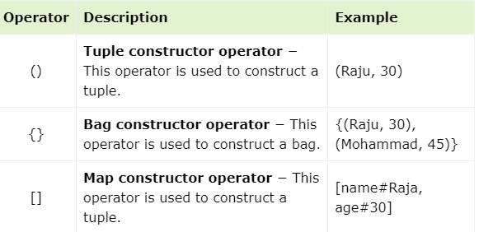
Type Constructor Operators

Slide 15
Relational Operators
Relational operators of big can be categorized as:
Loading and Storing
Diagnostic Operators
Filtering
Grouping and Joining
Sorting
Combining and Splitting

Slide 16
1. Loading and Storing
Apache Pig works on top of Hadoop. It is an analytical tool that analyzes large datasets that exist in the Hadoop File System. To analyze data using Apache Pig, we have to initially load the data into Apache Pig.
In MapReduce mode, Pig reads (loads) data from HDFS and stores the results back in HDFS.

Slide 17
The Load Operator
You can load data into Apache Pig from the file system (HDFS/ Local) using LOAD operator of Pig Latin.
Syntax:
Relation_name = LOAD 'Input file path' USING function as schema;

Slide 18
The Store operator
You can store the loaded data in the file system using the store operator.
Syntax:
STORE Relation_name INTO ' required_directory_path ' [USING function];

Slide 19
2. Diagnostic Operators
The load statement will simply load the data into the specified relation in Apache Pig. To verify the execution of the Load statement, you have to use the Diagnostic Operators.
Pig Latin provides four different types of diagnostic operators −
Dump operator
Describe operator
Explanation operator
Illustration operator

